Slide 1









Slide 2

Welcome
Virginia Military Advisory Council
31 March 2022
Virginia War Memorial
The Honorable Craig C. Crenshaw
Secretary of Veterans & Defense Affairs
Chair
2

Slide 3
Agenda
1300 - 1340 Welcome
Governor Youngkin remarks
Attorney General Miyares remarks
1340 - 1345 Break
1345 - 1400 Secretary Crenshaw remarks
1400 - 1430 Federal Update & Growing the Military Mission
The Roosevelt Group
Matrix Design Group
1430 - 1500 Networking break
1500 – 1520 Partners in PROMISE (Protecting the Rights of Military Children in Special Education)
1520 – 1555 Commanders’ Updates
1450 - 1500 Closing Remarks
Secretary Crenshaw

Slide 5
Growing the Military & Federal Update
Charlie Perham
MATRIX Design Group
John Simmons
Managing Partner, Roosevelt Group

Slide 6

VMAC Legislative Update
March 31, 2022
HONORED TO SERVE GREAT COMPANIES & COMMUNITIES

Slide 7


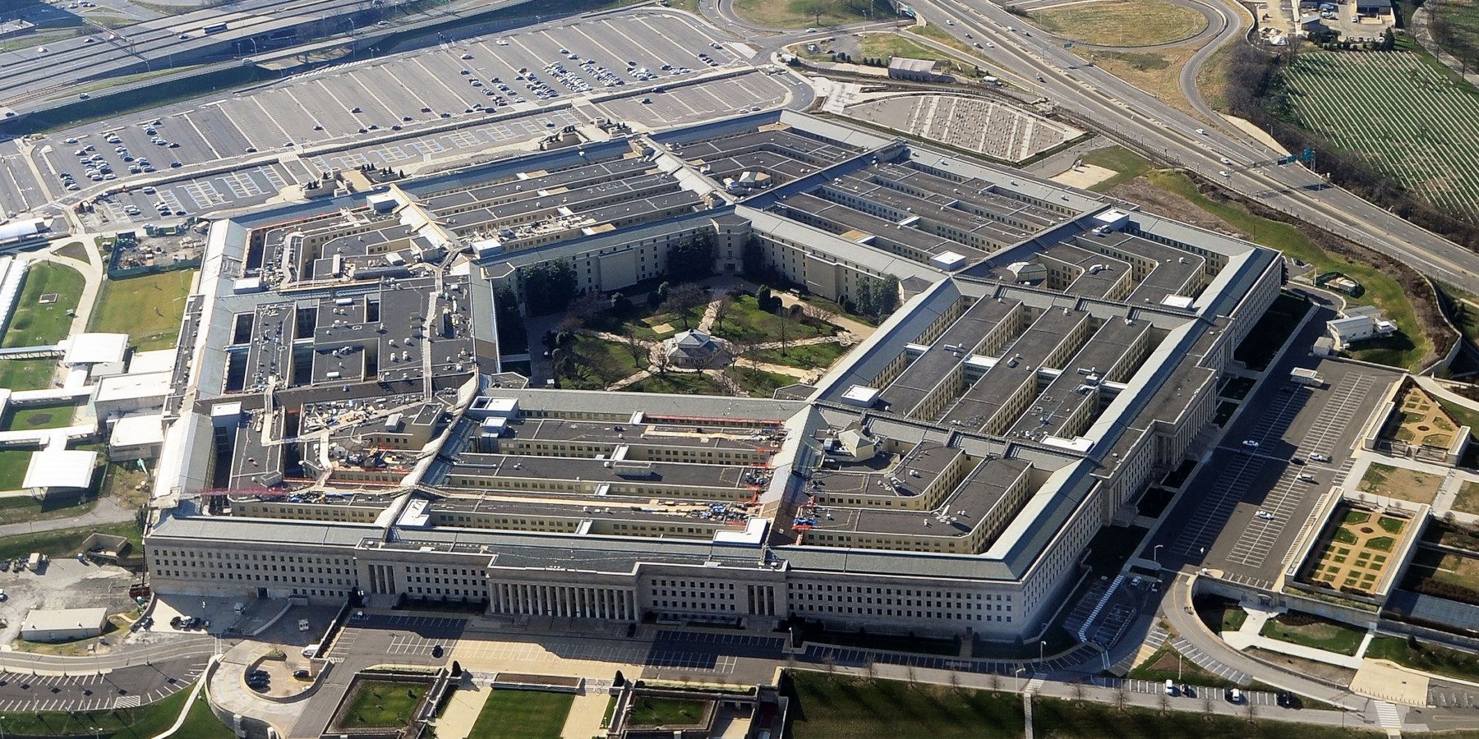
FY22 Omnibus Appropriations Bill
$1.5 Trillion Package
  $782 billion for defense spending (an increase of 6%)
  $730 billion for domestic spending (an increase of 7%)
Winners!
  $145B DoD Procurement - (Shipbuilding; USAF/Navy Aircraft; USAF Classified; National Guard & Reserve Equipment; Missile Defense Agency; Army Trucks/Helicopters/Ground Combat Vehicles; Navy “Shipyard Infrastructure Optimization Plan”
  $119B DoD RDT&E - Space; Micro-electronics; Missile Defense; T&E/Test Range Infrastructure; Classified; $2.4B USAF RDT&E; $1.7B Army RDT&E
  $15B DoD Milcon
Losers!
  $256B DoD Operations & Maintenance Account
  $167B DoD Military Personnel Account

Slide 8



FY22 Military Construction
$14.9B – $6.8B above the FY21 and $5B above the PBR
$224M Child Development Centers, $33M P&D - $204M above FY22 PBR
$929M Construction of Guard/Reserve Facilities - $259M above FY22 PBR
$625M Shipyard Infrastructure Optimization Plan (SIOP) - $465M above PBR
FY22 NDAA Conference Report Authorized Virginia Unfunded Priorities
$5.8M for VANG Army Aviation Support Facility (P&D)
$75M for NS Norfolk CMV–22 Aircraft Maintenance Hangar
$24M for AF JBLE Fuel Systems Maintenance Dock
Adopted all Services’ Unfunded Priority List (UPL) Items
$5.8M for VANG Army Aviation Support Facility (P&D)
$75M for NS Norfolk CMV–22 Aircraft Maintenance Hangar
$24M for AF JBLE Fuel Systems Maintenance Dock

Slide 9
FY22 Omnibus Milcon Provisions of Interest
Special Operations Command East Coast Training Facilities
“Directs the Secretary of Defense to provide a report within 180 days of enactment of this Act that outlines any training capability shortfalls of East Coast based sites and the feasibility of
developing an East Coast joint training center that focuses on enabling all-domain warfare. This
report should also analyze the value provided to the U.S. Special Operations Command by
National Guard training facilities.”
Energy Resilience and Conservation Investment Program (ERCIP)
“The agreement provides a total of $469,322,000 for ERCIP, which is an increase of $182,572,000 above the budget request. The Secretary of Defense is directed to submit a spend plan for the additional ERCIP funds no later than 30 days after enactment of this Act.”

Slide 10
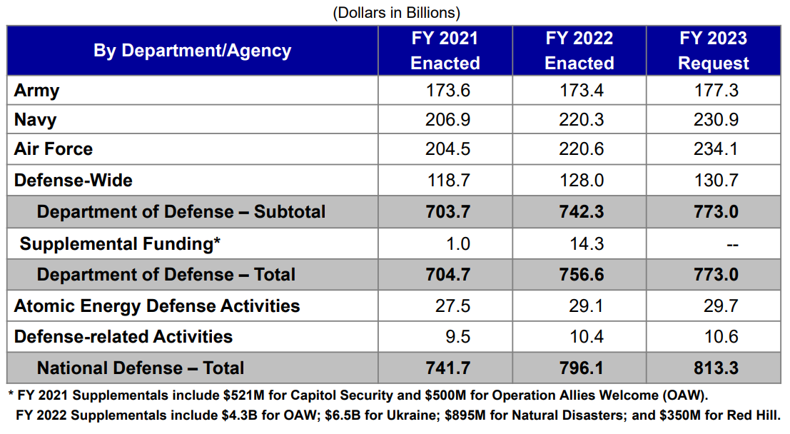
President Biden’s FY23 Defense Budget

Slide 11
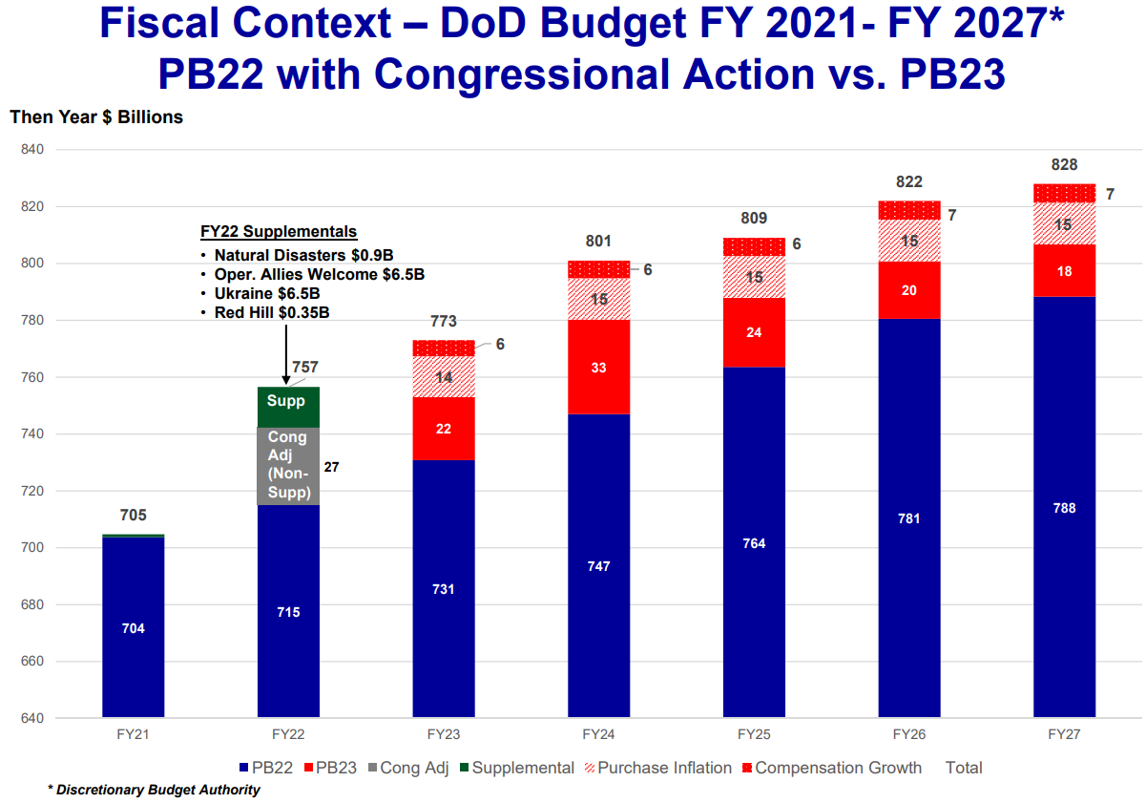
President Biden’s FY23 Defense Budget

Slide 12
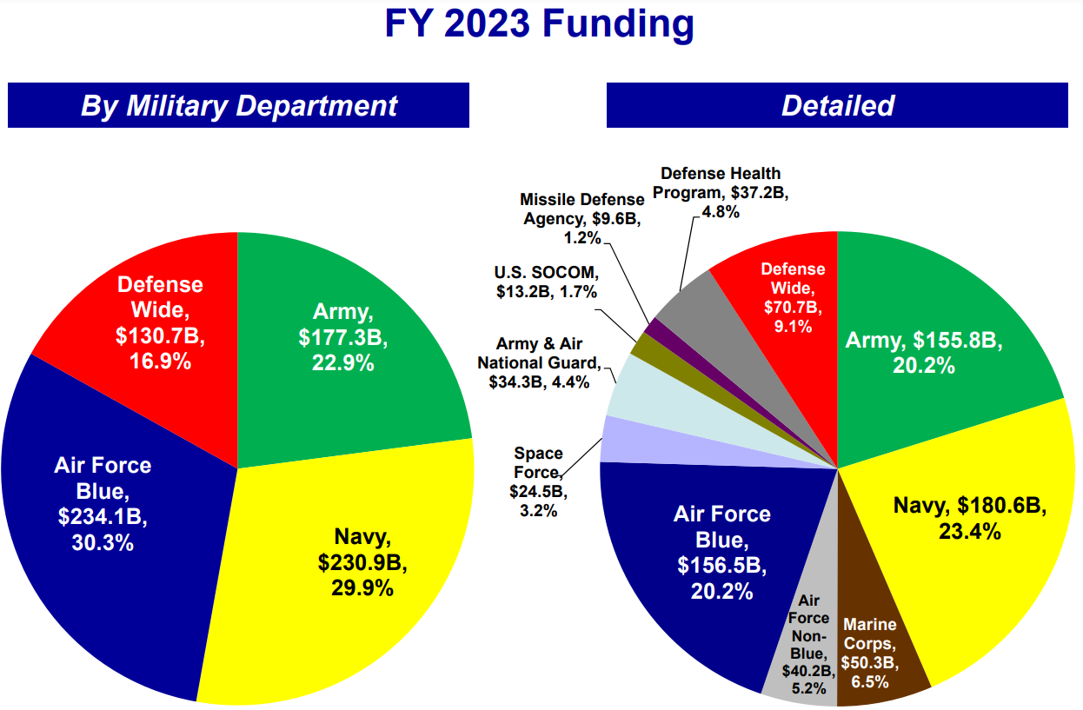
President Biden’s FY23 Defense Budget

Slide 13
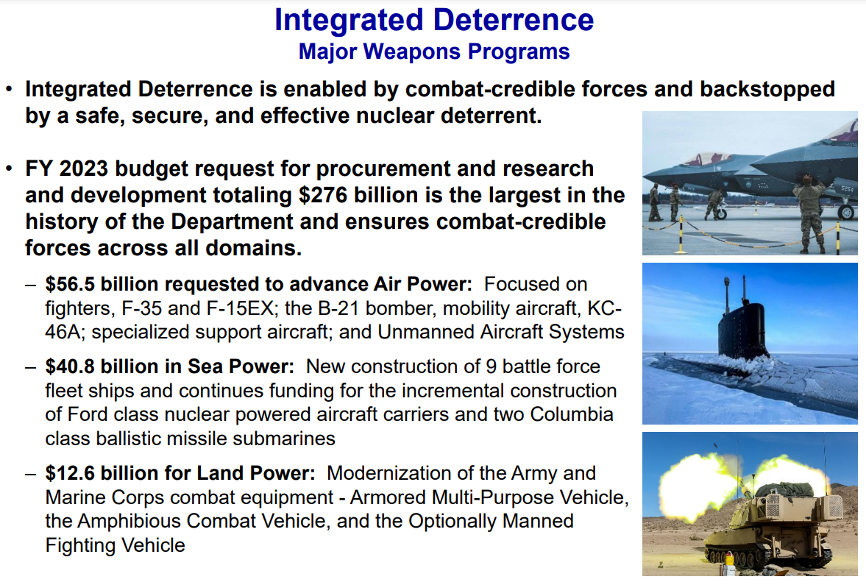
President Biden’s FY23 Defense Budget

Slide 14
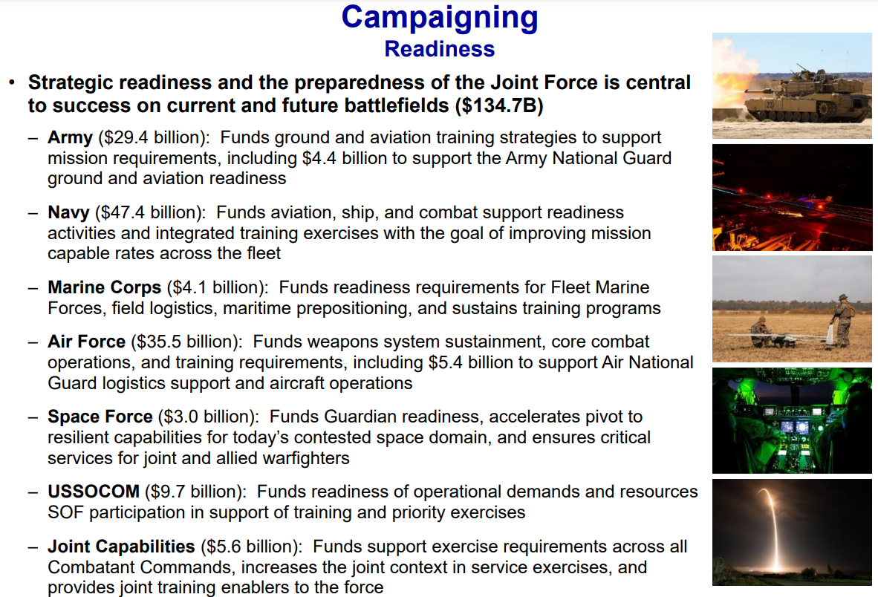
President Biden’s FY23 Defense Budget

Slide 15
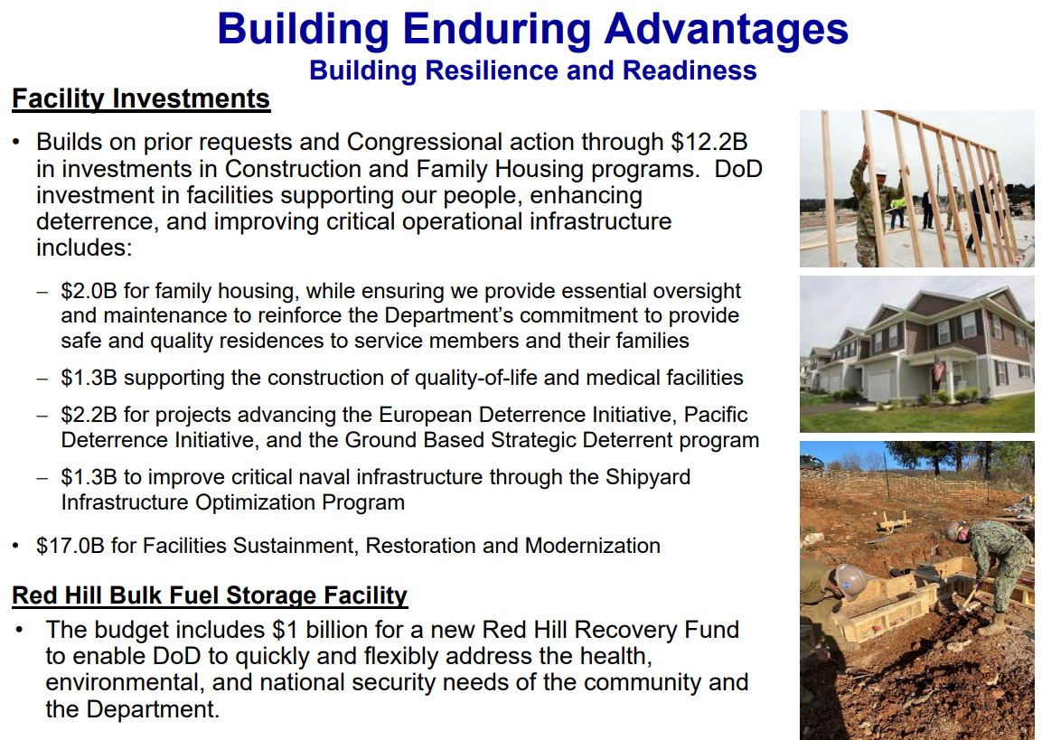
President Biden’s FY23 Defense Budget

Slide 16
FY23 PBR Impact on Virginia
Largest Pay Raise in 20 Years - Both Military and Civilian Force - 4.6 percent
Air Force Requests Retirement of 150 Airplanes
  Including 33 of its advanced F-22 fighters (non-combat coded aircraft)
Navy Requests Decommissioning of 24 Ships
  9 Freedom-class Littoral Combat Ships, 5 Ticonderoga-class cruisers, 2 Los Angeles-class submarines, 4 Landing Dock Ships, 2 oilers and 2 Expeditionary Transfer Docks
Army Requests Temporary Reduction in Active Force
  Army plans to reduce from 485,000 active duty force to 473,000 troops
  Will maintain 336,000 in the Army National Guard and 189,500 in the Army Reserve
  Increase end strength back to 485,000 active duty soldiers within five years
Increased Investment in 5G Technologies and Resilient Bases

Slide 17
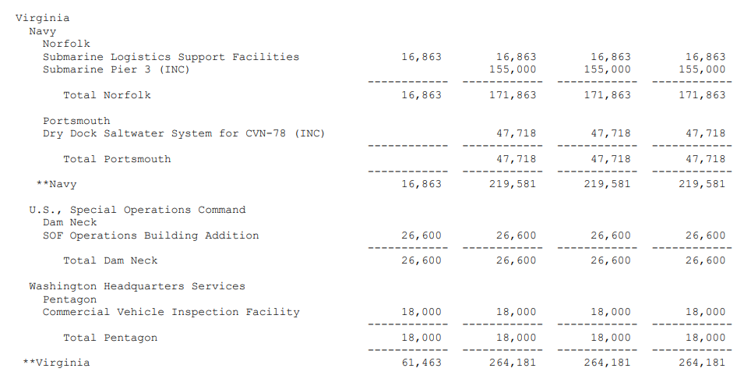
FY23 PBR Impact on Virginia

Slide 18
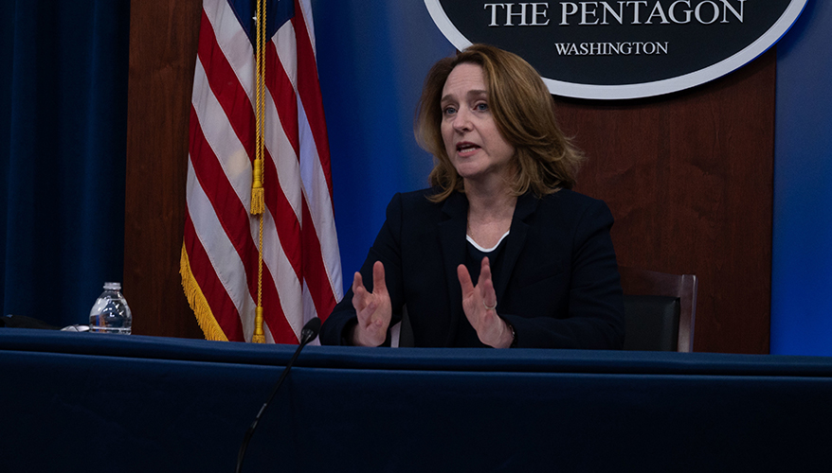
2022 National Defense Strategy
The National Defense Strategy (NDS) is used in the PPBE Process to establish the objectives for the plans for military force structure, force modernization, business processes, supporting infrastructure, and required resources (funding and manpower).
For the first time, DoD conducted strategic reviews in a fully integrated way – incorporating the Nuclear Posture Review (NPR) and Missile Defense Review (MDR). Unclassified version forthcoming.
Defending the homeland, paced to the growing multi-domain threat posed by the PRC
Deterring strategic attacks against the US, Allies, and partners
Deterring aggression, while being prepared to prevail in conflict when necessary, prioritizing the PRC challenge in the Indo-Pacific, then the Russia challenge in Europe
Building a resilient Joint Force and defense ecosystem

Slide 19
Networking Break
:30

Slide 20
Partners in PROMISE
(Protecting the Rights of Military Children in Special Education)
Michelle Norman
Founder and Executive Director, Partners in PROMISE
Kimberly Cody
Military Family Education Advocate

Slide 21





MILITARY CHILDREN IN SPECIAL EDUCATION
MICHELLE NORMAN, Founder and Executive Director, Partners in PROMISE
KIMBERLY CODY, Military Family Education Advocate

Slide 22


About Us
Protecting the Rights Of Military Children in Special Education
through elevating the voices of military family members to educate and advise military service organizations, Department of Defense, and public officials.
All children receiving special education are entitled to a free and appropriate public education.
Elevate Educate Advise
Notes:
MICHELLE
Discuss military affiliation (Navy spouse for over 25 years) and how you joined PIP
Our mission is to educate and empower our Exceptional Military Family Members on special education as well as advocate and advise our military service organizations, DOD and public officials on the special education challenges our children face.
It is our goal to remove those educational hurdles for our children so our service members can do what they do best - serve this great country.
We want our children to become independent and successful, productive members of society as any parent would want. We know that it is a daunting challenge when our families typically move every 2 - 3 years.
MEAGAN
We meet our mission through the three pillars of Elevate, Educate, and Advise. We strive to elevate the voices of EFMP families and tell their stories through a variety of mediums.
We educate parents, students, and leaders about special education law and connect them to resources-- this image is from our Trust Your Gut Campaign.
And We Advise leaders with the goal of informed policy decisions. We will talk a little about how we advise leaders, but a big part of it is through our annual survey findings - using data and stories to propose solutions.

Slide 23
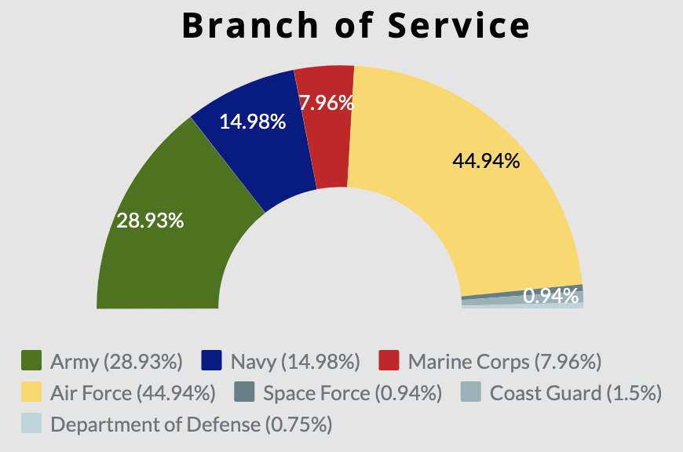
2021 Survey Reach & Demographics
Who took the survey?
24% Active Duty
65% Active Duty Spouse
32% E4 - E6
31% O4 - O6
26% E7-E9
13.5% stationed in VA
We heard from over 1,100 families
A 501(c)(3) Tax exempt organization
© 2022 Partners in PROMISE
A 501(c)(3) Tax exempt organization
Notes:
MICHELLE - Try to keep this slide to less than a minute, we are only leading with demographics given the audience. But let them read the details and just tell them the highlight: This is a representative sampling across all service branches and ranks, it reflects the makeup of the military, and more than doubled in size from last year’s survey.
Respondents constituted a representative sampling of the overall military population across all service branches. The majority of respondents were enlisted personnel (58.32%), with highest responses from E4-E6 (31.51%) and E7-E9 (26.30%). Mid-rank officers also responded in similar numbers with 30.62% of responses coming from O4-O6 and 7.88% from O1-O3 level officers. This phenomenon of lower response rates from younger members of the military population has been studied by Miller et. all and is fairly standard within the military survey community. Most respondents were aged 36 - 40 (31.06%) with 24.47% aged 31 - 35. This is in line with last year’s findings and aligns with the ages of parents with children in special education. Seventy-two percent of respondents identified as white or caucasian with 5.55% black/African American and 12.34% Hispanic or Latino origin. Eighty-four percent of respondents identified as female, 13% male, .36% were non-binary and 1.8% preferred not to answer. Sixty-five percent of respondents identified as either an active-duty or veteran military spouse, with 23.45% indicating they were an active-duty servicemember. The majority (86%) are located within the Continental United States (CONUS) with 14% residing Outside the Continental United States (OCONUS).
Service branch representation was Air Force respondents responded in the highest rate, with 43%, followed by 31% from Army, 16% from Navy, 8% from Marine Corps, 1% from Space Force and 1% from the Coast Guard. The Air Force response rate was higher than expected (Air Force represents roughly 24% of the total force) largely due to a strategic distribution of the survey by the Chief of Staff for the Air Force’s spouse. Her social media post resulted in a spike in Air Force responses. Prior to this, service branch responses made up a representative sampling of the military. This disproportionate number of Air Force responses was accounted for during analysis.

Slide 24
Key Findings
77% went without special education services for over 60 days after a move.
5.75 months is the average number of months families waited for special education after a move.
Virginia was top state for reported timeline violations
Parents are unfamiliar with resource and Special Education services in place to help them, including:
  MiC3
  Advance Enrollment
  Federal Impact Aid Form
  Compensatory Services
  Legal support

Slide 25
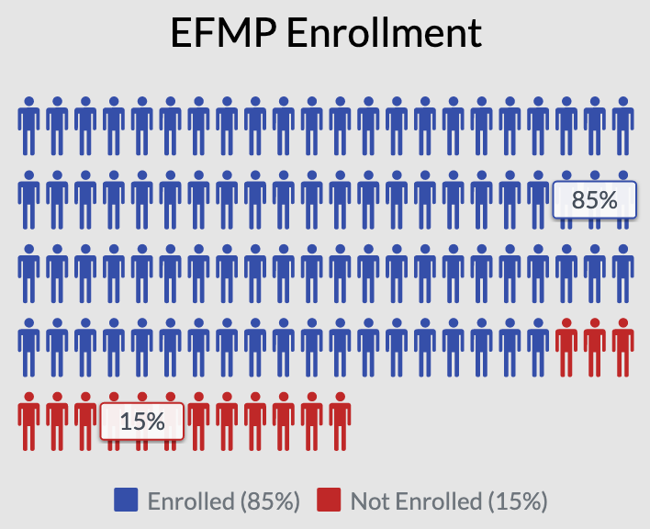
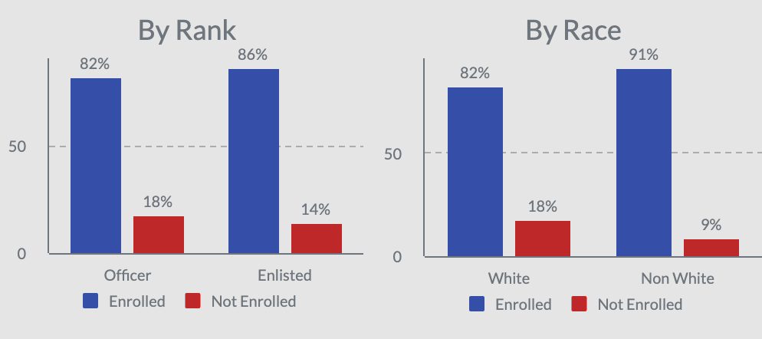
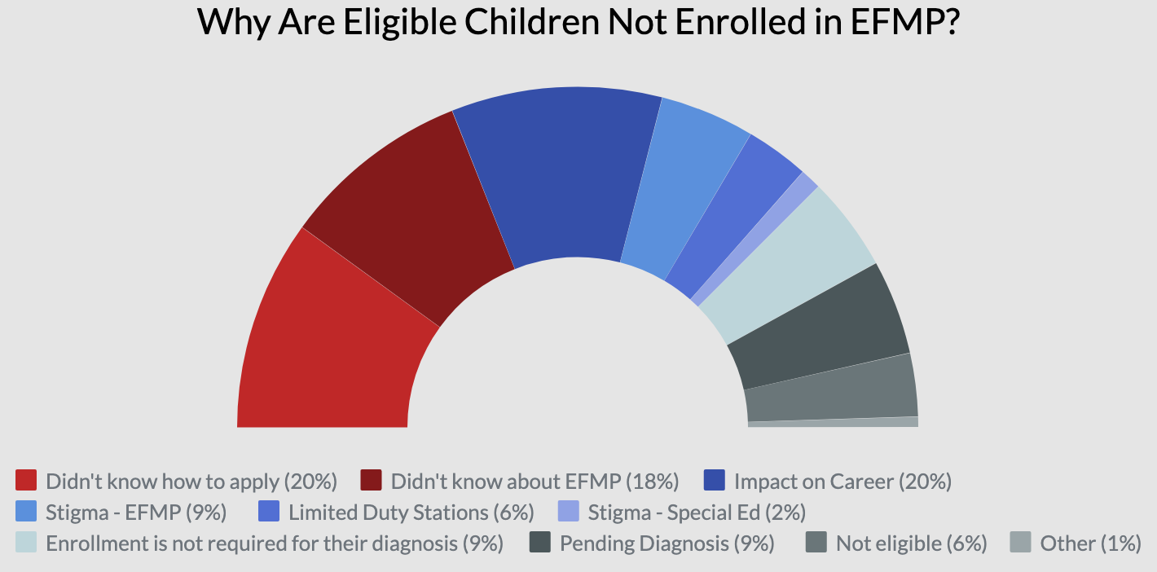
Additional Survey Findings:
EFMP Enrollment
Despite being a mandatory enrollment program, not all families choose to notify military personnel of their Exceptional status and enroll in the Exceptional Family Member Program (EFMP) mandatory enrollment.
© 2022 Partners in PROMISE
A 501(c)(3) Tax exempt organization
Notes:
Method
Families were asked to rank how familiar they were with a variety of special education concepts and military/EFMP support services. Based on their answers, respondents were then given a score of being "informed" or "uninformed" about the services and supports that are in place to assist their children.
We found that being informed had a relationship with improved access to special education resources.

Slide 26
Recommendations in Virginia
Advance Enrollment
Ensure all schools are aware of this option and identify barriers for registration (rental contracts, utilities, logistics, off-season enrollments)
Update GUIDANCE FOR MILITARY FAMILIES WITH STUDENTS IN SPECIAL EDUCATION FEBRUARY 2020
SLOs, EFMP Coordinators, Installation Commanders, and Military Liaisons
Provide Special Education Advocacy training
Communicate clearly with families what the installation offers and how to contact them ( special education legal and advocacy resources)
Representation
Include an active duty family with a child receiving SPED and State Waiver services on councils for education
Consider establishing Military Family Advisory Councils for school district school board with inclusion of one member with a child in special education
Partnerships
Support the streamline of public-private partnerships, share nonprofit resources and surveys, create MOUs to maximize outreach
Address compensatory services due to COVID, impact aid issues with Interstate Compact on the Educational Opportunity for Military Children

Slide 27

COMMANDERS’ UPDATES

Slide 28
NSA South Potomac Update
Naval Support Facility Dahlgren
Installation Updates
      Health Protection Condition Bravo (HPCON B)
        No masks required in most Navy Facilities; 50% indoor capacity
      Congressional Visit: US Rep. Rob Wittman 28 January
      19th Space Defense Squadron Activation Ceremony (US Space Force) 6 April
    Partnership Initiatives
      Intergovernmental Service Agreements (IGSA) with King George County:
        Wastewater Treatment Plant Chemicals
      Coordination with State Historic Preservation Office on potential PPV initiative to update / modernize residential housing
      NSA South Potomac working with King George County on Military Overlay Zoning
      REPI Challenge Proposal submitted (20 March)
      Collaboration with William & Mary to survey eagle nesting – numbers are increasing

Slide 29
Closing Remarks
The Honorable Craig C. Crenshaw
Secretary of Veterans & Defense Affairs
Chair

